Slide 1
Students’ drinking behavior during on-campus desk and facility job
IS 698 |Smart Home Health Analytics
Research Project By – Charu Saklecha & Anand Jain

Slide 2
Motivation
Ignorant of dehydration during long work hours
65% of Americans are dehydrated at work
Adverse effects of dehydration lead to a chronic disease
Dehydration can worsen cognitive performance up to 51%
Notes:
Students /people usually ignore amount of water intake during work
Causing Dhydration..leading to palpitation (irregular heartbeat) , high conductance level, less blood volume pulse and ultimately..the favourite enemy of every person in recent time.. STRESS
How physiological sensors are affective in analyzing the data
To investigate the influence of dehydration or low water levels on your heart rate and EDA

Slide 3
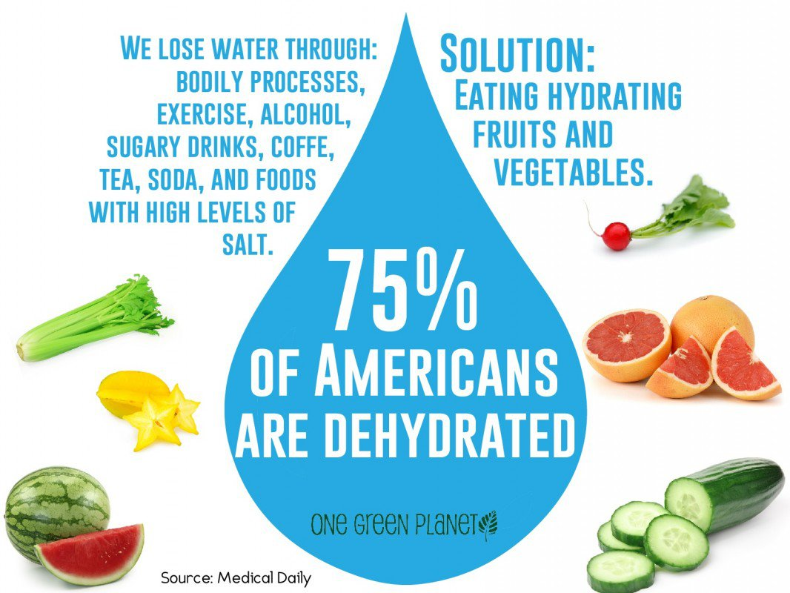

Slide 4
Introduction
Dehydration plays an important role in discerning the variations coming up in the physiological activity of a student
Water intake varies at different type of workplace
Intent of this research work is to analyze the changes in heart rate levels of a student depending on the drinking behavior during different kind of jobs
Notes:
Aim is to find out the change in hear beat,Blood volume pulse and skin conductance levels
When we ae at work.We often forget to drink water.Apps are out there to remind you.But how useful the ayre.it is quite debatable
We have narrowed down our scenarios to a student’s life at on campus/desk job.at job likes dining hall/food courts.You are not allowed to have yyour phones while working.Continous work for long durations without water may cause severe consequences.

Slide 5
Device Description
Empatica E4 wristband - captures EDA, Heart rate & motion activity data in real time
‘Empatica Manager’ - to upload the recorded data on cloud storage
‘Empatica Connect’ - to view, organize, evaluate and download the raw sensor data

Slide 6
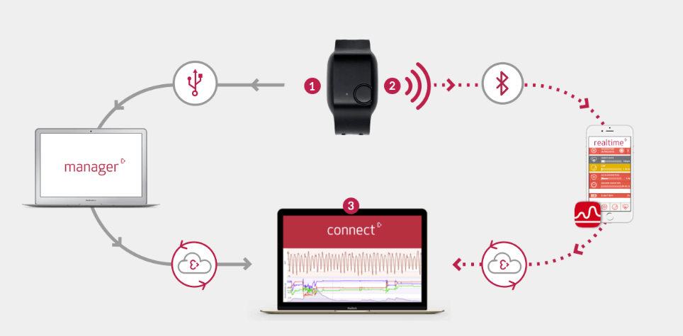

Slide 7
Sensor Data Specification
Sensor | Unit / Range | Sampling Frequency
Temperature | Celsius (°C) | 4 Hz
Accelerometer | [-2g, 2g] | 32 Hz
Photoplethysmograph |  | 64 Hz
EDA | μS (micro Siemens) | 4 Hz
Inter Beat Interval |  | 1/64 second resolution
Heart rate | BPM (beats per minute ) | 1 Hz

Slide 8
Data Collection
Data Accumulation
  2 Scenarios , 2 Subjects , 10 minutes
First scenario (Desk Job) – With water & Without water
  At library and other departments which includes minimal hand movements like typing etc.
Second scenario (Facilities Job)- With water & Without water
  Facility job-At university dining hall which has physical activity like lifting , walking ,bending and hand movements
Notes:
Data was collected for 10 mins for each scenario.Being dehydrated for 1 hour
The duration between the scenarios was 30 min.As water absorption takes 11-13 mins.Ideally,the quantity of water gets absorbed aafter 120 mins.
But the changes can be seen after 30 min.
After having a glass of water, collected data was labelled as ‘with water’

Slide 9
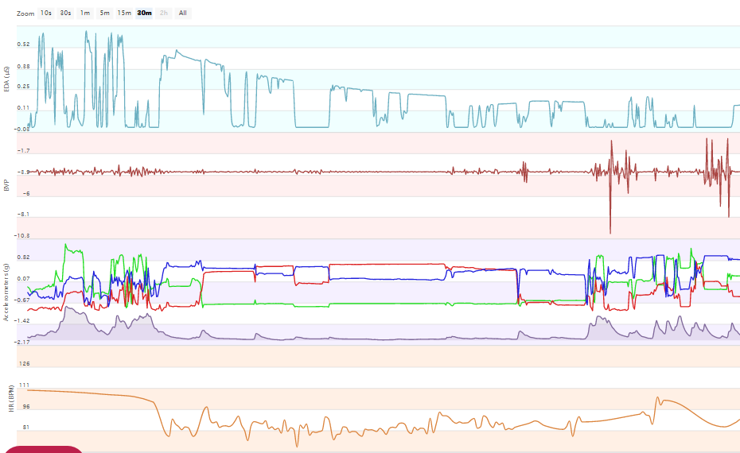

Slide 10
Sensor Data Selection
Heart rate- When body is dehydrated , heart rate elevates upto 10 bpm.
Skin conductance level determined by EDA varies depending on hydration level.
Inter-beat Interval (IBI) & Heart rate was extracted from the BVP signal
Notes:
Due to these these attributes were selected for computation of features and hence model construction

Slide 11
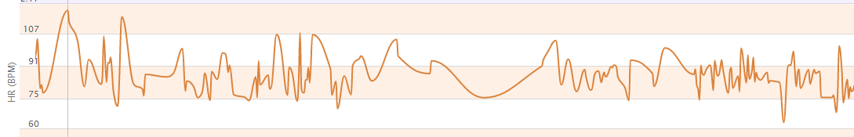
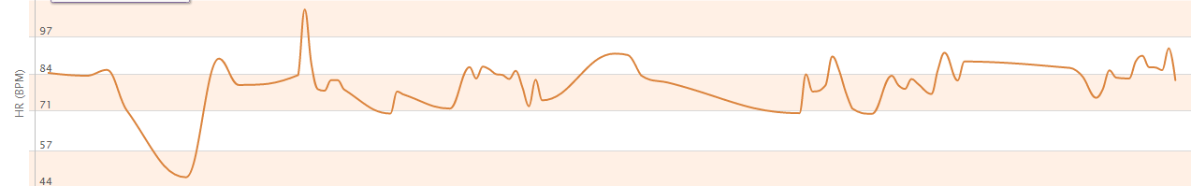
Avg HR | Without water |Facilities- 98.6
Avg HR | With water |Facilities- 75.8
Notes:
Average HR beat -60-80
Spikes for HR..DUE TO DHYDRATION..palipa

Slide 12
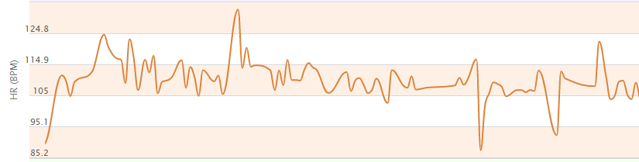
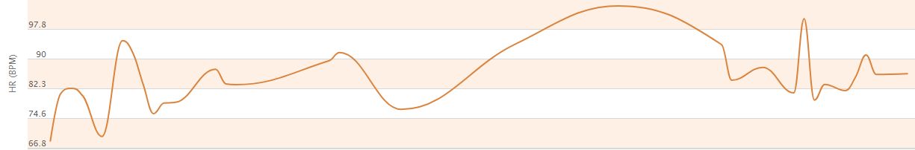
Avg HR | Without water |Desk job- 90.44
Avg HR | With water | Desk job- 74.19

Slide 13
Data Preprocessing
Removal of missing and erroneous data
Resampling of data
Removal of null values from EDA data
Notes:
Example of 0’s In EDA and abrupt values in temp
MISSED beats in R-R INTERVAL

Slide 14
Feature Extraction
Heart rate and EDA were chosen among the attributes for feature extraction.
Skin conductance level and Heart Rate Variability analysis were performed to extract features.
Notes:
To compute the features for further analysis and classification

Slide 15
Extracted features
Feature | Description
Mean HR | Mean of Heart rate(beats per minute)
Standard deviation HR | Standard deviation of instantaneous heart rate values
Mean IBI | Mean of R-R intervals
Standard deviation IBI | Standard deviation of R-R intervals
Mean EDA | Mean of EDA values
Standard deviation EDA | Standard deviation of EDA values

Slide 16
Classification
Accelerometer data was added to compute further analysis to detect job type as desk or facilities
4 classification algorithms used.
Analysis done using Weka tool.
Notes:
With all the acclrmtr, EDA data algrothims were run on Weka to determine accuracy and FPR

Slide 17
Classification model
Classifier | Accuracy | False positive (facility) | False positive (desk job)
Naïve Bayes | 96.09993% | 0.012 | 0.059
KNN (K=2) | 99.535% | 0.005 | 0.005
OneR | 82.8369% | 0.134 | 0.200
Decision Tree | 98.8652% | 0.008 | 0.014
Notes:
Naïve bayes- 96.09993 fp -0.012 fac sed 0.059
KNN - 99.5.35 FP-.005 0.005
ONE R 82.8369 -0.134 .2000 MEAN EDA
DECISION TREE -98.8652 -.008 .014
Model is effective to classify into desk/facility with z-axis as dominant feature

Slide 18
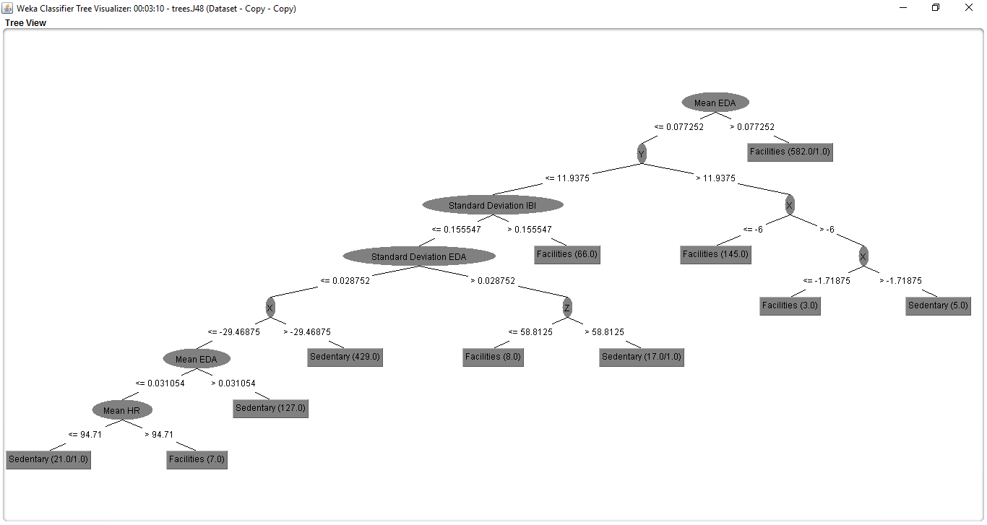
Notes:
Mean EDA was the dominant feature.for better visualization.
One R- mean EDA

Slide 19
Feature Selection
Top 5 features using correlation
  SD IBI
  Z-axis
  Mean EDA
  SD EDA
  Y-axis

Slide 20
Accuracy Comparison
Classifier | Accuracy (Full dataset) | Accuracy (Feature selection)
Naïve Bayes | 96.09993% | 96.1702%
KNN (K=2) | 99.535% | 99.652%
OneR | 82.8369% | 82.8369%
Decision Tree | 98.8652% | 99.007%

Slide 21
Accuracies for Facilities Job for Full Feature set
Classifier | Accuracy | False Positive(Without water) | False Positive(With water)
Naïve Bayes | 99.8454% | 0.003 | 0.00
KNNN | 99.92% | 0.00 | 0.00
OneR | 100% | 0.00 | 0.00
Decision Tree | 99.9247% | 0.002 | 0.00
Notes:
For full feature .one R classifies mean EDA

Slide 22
Feature Selection
Top 3 features
  SD IBI
  Mean HR
  Mean IBI
Notes:
When we selected only 1 feature.SD IBI…GOT SAME ACCURACY..DOMInant feature

Slide 23

Accuracy Comparison
Classifier | Accuracy | Accuracy(Feature selection)
Naïve Bayes | 99.8454% | 99.8954%
KNNN | 99.92% | 100%
OneR | 100% | 100%
Decision Tree | 99.9247% | 99.9354%
Notes:
For full feature .one R classifies mean EDA
One R-SD IBI being the best feature

Slide 24
Desk Job
Classifier | Accuracy | False Positive(without water | False Positive (with water)
Naïve Bayes | 87.1237% | 0.014 | 0.290
KNN | 99.4983% | 0.003 | 0.008
OneR | 81.9398% | 0.194 | 0.161
Decision Tree | 98.8294% | 0.009 | 0.016

Slide 25
Feature Selection
Top 3 features
  Mean IBI
  Mean HR
  SD EDA

Slide 26
Accuracy Comparison
Classifier | Accuracy | Accuracy (Feature Selection)
Naïve Bayes | 87.1237% | 74.916%
KNN | 99.4983% | 94.4816%
OneR | 81.9398% | 81.9398%
Decision Tree | 98.8294% | 92.4612%
Notes:
Performed it with best feature.MEAN IBI
But accuracies decreases

Slide 27
Results
Model was able to effectively classify between the desk and facilities job
Heart rate depicted significant changes when the water intake was low.
SD IBI– this feature was the dominant feature to distinguish between with/without water cases in the facilities job. While, this was the worst feature in desk job.
Our model was able to classify with/without water efficiently (almost above 90% accuracy for all classifiers) in sedentary position.

Slide 28
Future Enhancements & Limitations
Wearable device can be merged with the specified model to provide instantaneous heart rates along with the hydration level.
This could be done with water reminder apps like- ‘Water reminder’ could be incorporated with real–time hydration notifications depending upon the heart rate.
One of the limitation of device was electrodes losing contact with surface of skin resulting in missing data
Optical sensing will be the future using infrared light in wearable devices.
Notes:
-step count
-apps are used to measure the water intake
-

Slide 29
Related Work
"Automatic Identification of Artifacts in Electrodermal Activity Data" In Proc. International Conference of the IEEE Engineering in Medicine and Biology Society (EMBC), Milan, Italy, August 2015.
“The Electrodermal System,” Handbook of psychophysiology, p. 159, 2007
“Effects of short-term psychological stress on the time and frequency domains of heart-rate variability,” Perceptual and motor skills, vol. 91, no. 2, pp. 515–524, 2000.

Slide 30
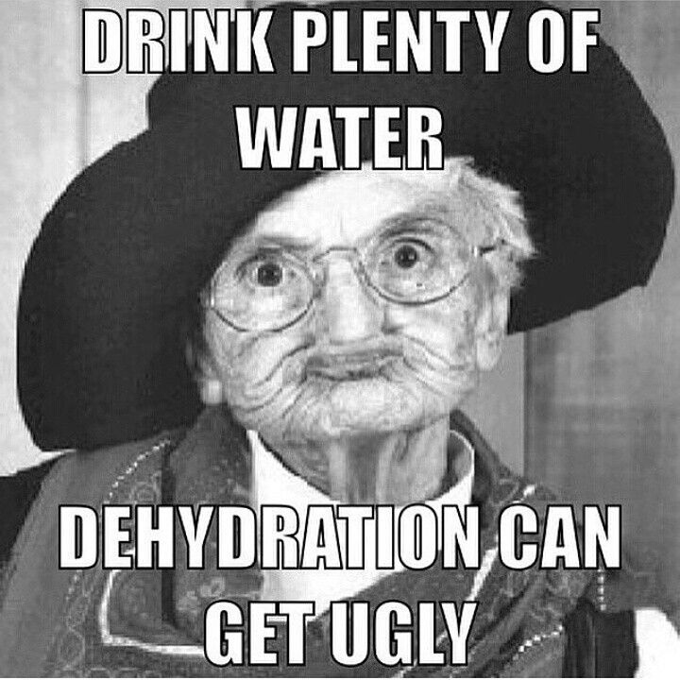
THANK YOU

